Slide 1
ETL

Slide 2
WHAT IS A VIEW
A View is just an SQL statement, and the associated data is not physically stored in the view but in the base tables of it. It can be made over one or more database tables. Generally, we put those columns in view that we need to retrieve/query again and again. Once you have created the view, you can query the view as a table. We can make an index, and trigger on the view.

Slide 3
WHAT IS A VIEW
  Security: Views can restrict access to certain columns or fields of a table, improving security by preventing users from seeing sensitive data they do not need.
  Data Abstraction: Views provide an abstraction layer so that users do not need to be aware of all underlying tables or columns in the database.
  Filtering: A view can act as a filter on referenced tables, returning only rows (and columns) that meet specified criteria.
  Multiple Data Sources: A view can be defined using queries that reference one or more tables, other views, or even data stored on remote servers through distributed queries.
  Combining Data: When data is distributed across multiple servers (for example, each storing region-specific data), views can combine these data sets into a unified, queryable result.

Slide 4
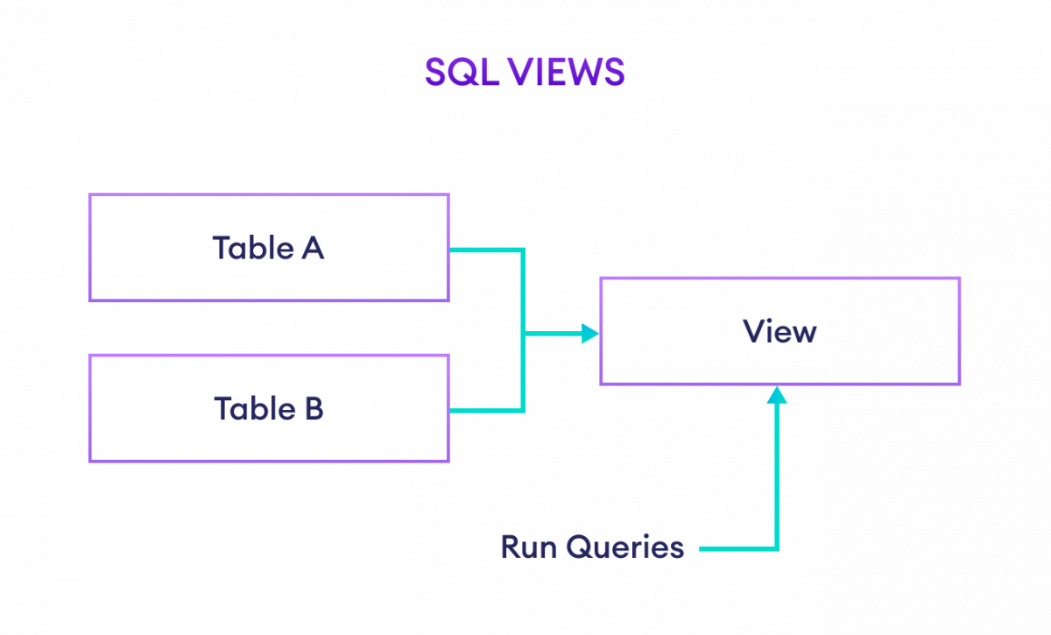
WHAT IS A VIEW

Slide 5
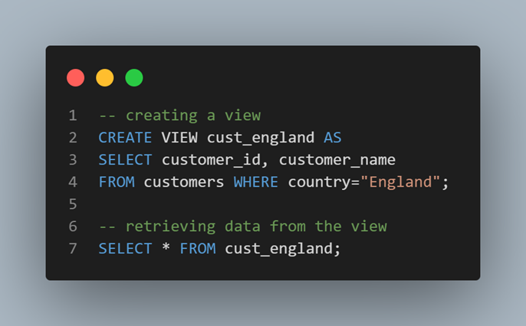
VIEW SYNTAX
CREATE VIEW view_name AS
SELECT column1, column2, ...
FROM table_name
WHERE condition;

Slide 6
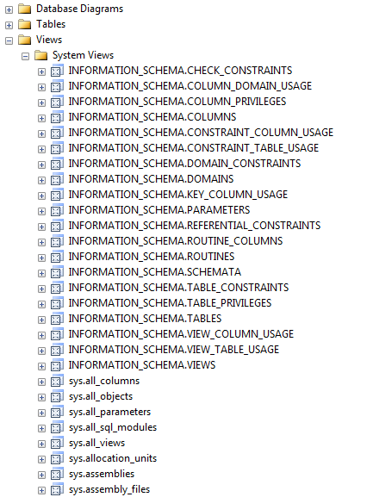
SYSTEM DEFINED VIEWS

Slide 7

SYSTEM DEFINED VIEWS
This query retrieves information about all tables in the current database from the system catalog view sys.tables. The sys.tables view is a system-defined view in SQL Server that contains metadata about tables in the database, such as their names, object IDs, schema names, and creation dates.

Slide 8
SYSTEM-DEFINED VIEW IN SQL
  Accessing Metadata: These views allow users to query and retrieve information about the structure and configuration of the database.
  Monitoring Database Performance: DBAs and system administrators can use these views to identify performance bottlenecks, optimize query execution plans, and troubleshoot performance issues.
  Managing Security: System-defined views can assist in managing security and access control within the database.
  Auditing and Compliance: System-defined views can be used for auditing and compliance purposes by tracking changes to database objects, user activities, and system events.
  Generating Reports: System-defined views can serve as data sources for generating reports and dashboards within the database management system or external reporting tools.

Slide 9
INFORMATION SCHEMA VIEW
In SQL Server we have twenty different schema views. These are used to display information in a database, like tables and columns. This type of view starts with INFORMATION_SCHEMA and after this view name.
To create an Information Schema View, you don't need to define or create it manually, as it's already provided by the database system. You can just query these views to retrieve metadata about the database objects.

Slide 10

SYNTAX TO QUERY THE INFORMATION SCHEMA VIEW

Slide 11
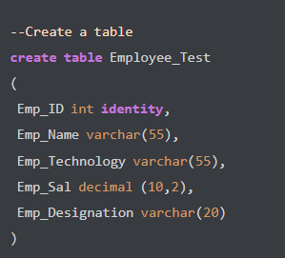

SYNTAX INFORMATION SCHEMA VIEW
1- Create a table
2- To view detailed information on the columns of table Employee_Test

Slide 12
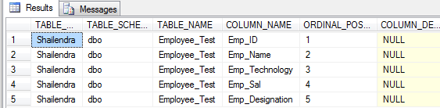
SYNTAX INFORMATION SCHEMA VIEW

Slide 13
USE CASES INFORMATION SCHEMA VIEW
  Data Dictionary Queries: It allows users to query metadata about database objects, such as tables, columns, and constraints.
  Schema Comparison: Information Schema Views enable users to compare the schema of different databases or database versions.
  Dynamic SQL Generation: They provide a dynamic way to generate SQL statements dynamically based on the database's schema.
  User Privilege Management: This includes information about user privileges and permissions granted within the database.
  Database Documentation: They serve as a valuable resource for documenting database structures and configurations.
  Data Profiling and Analysis: By querying these views, analysts can gather statistical information about the distribution of data values, data types, or column cardinality, helping to identify data quality issues or optimization opportunities.

Slide 14
WHAT IS A MATERIALIZED VIEW?
  Physical Storage: Unlike regular (virtual) views, materialized views store the results of a query as an actual, physical table.
  Precomputation of Data: The data in a materialized view is precomputed, eliminating the need to repeatedly execute complex queries.
  Incremental Updates: Materialized views can be updated on a schedule or on-demand, ensuring the stored data stays reasonably current.
  Performance Boost: Frequent and/or complex aggregations can be retrieved quickly because results are already computed and stored.
  Best Use Cases: They are especially beneficial when underlying data changes infrequently or when high-cost queries are run repeatedly.

Slide 15
VIEW VS MATERIALIZED VIEW
VIEW | MZ VIEW
View is just a named query. It doesn't store anything. | Materialized view Stores data physically and get updated periodically.
When there is a query on view, it runs the query of the view definition. Actual data comes from underlying tables. | While querying MV, it gives data from MV.
Slow perfomance for SELECT queries. | Fast Performance for SELECT Queries.

Slide 16
WINDOW FUNCTIONS
Window Functions are a powerful feature in SQL that allows you to perform calculations across a set of rows related to the current row. They provide a way to compute running totals, moving averages, rankings, and other analytical calculations.

Slide 17
BENEFITS OF WINDOW FUNCTIONS
  Preserves Row-Level Data – Unlike GROUP BY, window functions keep individual rows intact while applying calculations.
  Facilitates Complex Analytics – Enables ranking, running totals, and moving averages efficiently.
  Enhances Performance – More optimized than using multiple self-joins or subqueries.
  Improves Readability – Queries are easier to write and understand compared to traditional aggregations.

Slide 18
USE CASES OF WINDOW FUNCTIONS
  Ranking Data – Using ROW_NUMBER(), RANK(), and DENSE_RANK() to create rankings without grouping data.
  Running Totals – Using SUM() OVER() to compute cumulative totals within a partition.
  Moving Averages – Using AVG() OVER() for trend analysis in financial and business reports.
  Comparative Analysis – Using LAG() and LEAD() to compare current and previous row values for business intelligence.

Slide 19
COMPONENTS OF WINDOW FUNCTIONS
Window functions require the OVER() clause, which defines the window frame. The key components are:
PARTITION BY – Divides the data into groups for calculations.
ORDER BY – Specifies the order in which the function is applied.
ROWS/RANGE – Defines the frame of rows to consider.

Slide 20
ROW_NUMBER()
Assigns a unique row number to each row within a partition.
SELECT employee_id, department, salary,
ROW_NUMBER()
OVER ( PARTITION BY department ORDER BY salary DESC ) AS row_num
FROM employees;

Slide 21
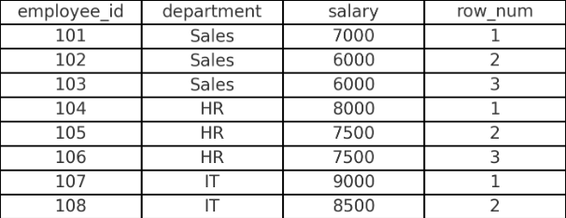
ROW_NUMBER()
PARTITION BY department groups data by department.
ORDER BY salary DESC sorts salaries in descending order within each department.
ROW_NUMBER() assigns a unique number to each row in the ordered partition

Slide 22
RANK()
Assigns a rank to each row within a partition, but allows duplicate ranks, skipping subsequent numbers.
SELECT employee_id, department, salary,
RANK()
OVER ( PARTITION BY department ORDER BY salary DESC ) AS rank
FROM employees;

Slide 23
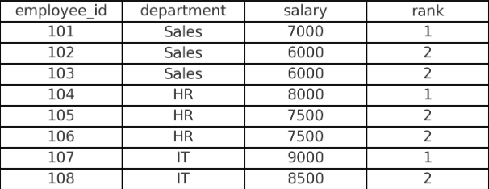
RANK()
Similar to ROW_NUMBER(), but RANK() assigns the same rank to equal values.
The next rank is skipped for duplicate values (e.g., if two employees have rank 1, the next rank is 3).

Slide 24
DENSE_RANK()
Similar to RANK(), but does not skip ranks.
SELECT employee_id, department, salary,
DENSE_RANK()
OVER ( PARTITION BY department ORDER BY salary DESC) AS dense_rank
FROM employees;

Slide 25
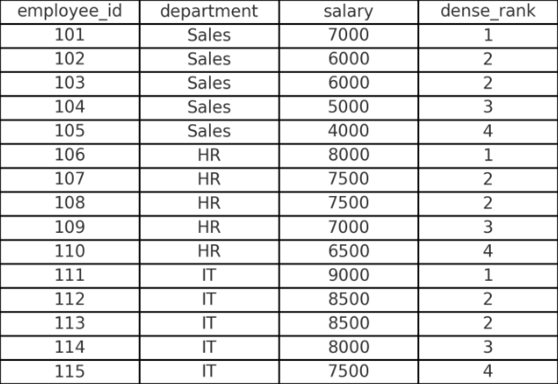
DENSE_RANK()
Like RANK(), but does not leave gaps in rankings.
If two employees have the same salary, they get the same rank, but the next rank follows sequentially.

Slide 26
SUM() OVER() - Running Total
Computes a cumulative sum over a partition.
SELECT employee_id, department, salary,
SUM(salary)
OVER ( PARTITION BY department ORDER BY employee_id ) AS running_total
FROM employees;

Slide 27
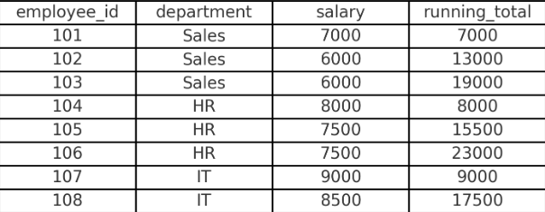
SUM() OVER() - Running Total
SUM(salary) OVER(...) calculates a cumulative sum.
PARTITION BY department ensures the sum resets for each department.
ORDER BY employee_id determines the sequence for calculating the running total.

Slide 28
AVG() OVER()
Calculates the moving average within a partition.
SELECT employee_id, department, salary,
AVG(salary)
OVER ( PARTITION BY department ) AS avg_salary
FROM employees;

Slide 29
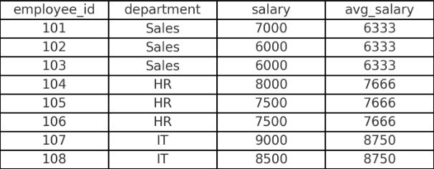
AVG() OVER()
AVG(salary) OVER(PARTITION BY department) computes the average salary per department.
Since there is no ORDER BY, all rows in the same department get the same average.

Slide 30
CONCLUSION
Window functions are essential for advanced analytics in SQL, providing flexible ways to compute rankings, cumulative sums, and averages while maintaining row-level details. By understanding their structure and applications, you can significantly enhance data analysis and reporting capabilities in SQL databases.

Slide 31
CASE
The CASE expression goes through conditions and returns a value when the first condition is met (like an if-then-else statement). So, once a condition is true, it will stop reading and return the result. If no conditions are true, it returns the value in the ELSE clause.
If there is no ELSE part and no conditions are true, it returns NULL.

Slide 32
CASE
CASE
WHEN condition1 THEN result1
WHEN condition2 THEN result2
WHEN conditionN THEN resultN
ELSE result
END;

Slide 33
CASE
OrderDetailID | OrderID | ProductID | Quantity
1 | 10248 | 11 | 12
2 | 10248 | 42 | 10
3 | 10248 | 72 | 5
4 | 10249 | 14 | 9
5 | 10249 | 51 | 40

Slide 34
CASE
SELECT OrderID, Quantity,
CASE WHEN Quantity > 30 THEN 'The quantity is greater than 30'
WHEN Quantity = 30 THEN 'The quantity is 30'
ELSE 'The quantity is under 30'
END AS QuantityText
FROM OrderDetails;

Slide 35
CASE
OrderID | Quantity | QuantityText
10248 | 12 | The quantity is under 30
10248 | 10 | The quantity is under 30
10248 | 5 | The quantity is under 30
10249 | 9 | The quantity is under 30
10249 | 40 | The quantity is greater than 30
10250 | 10 | The quantity is under 30
10250 | 35 | The quantity is greater than 30
10250 | 15 | The quantity is under 30

Slide 36
WHAT IS DATA ENGINEERING
Data engineering is the practice of taking raw data from a source, processing it, and storing it in an organized format suitable for downstream purposes such as analytics, business intelligence (BI), or machine learning (ML).
Essentially, data engineering prepares data so that value can be extracted from it.

Slide 37
WHAT IS DATA ENGINEERING
Key Components of Data Engineering
Ingest:
  Bring data from one or more sources (e.g., files, databases, applications, real-time streams) into a data platform.
Transform:
  Convert raw ingested data into a structured, usable format via a series of steps or transformations (filtering, standardizing, cleaning, aggregating).
  Often involves a medallion architecture (Bronze, Silver, Gold stages).
Orchestrate:
  Schedule, monitor, and control the data pipeline’s ingestion and transformation processes.
  Handle failures, for instance by rerunning a job if needed.

Slide 38
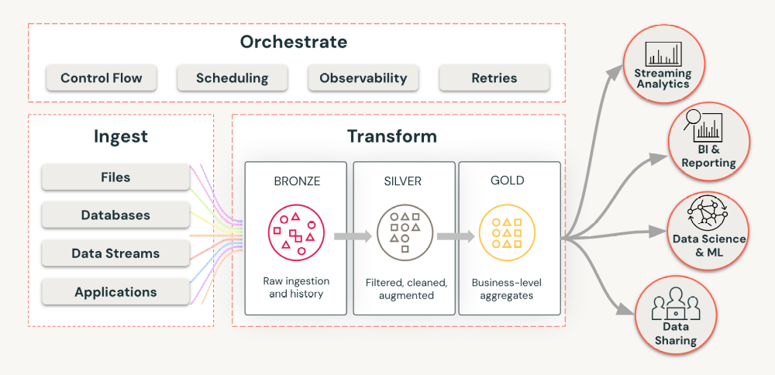
WHAT IS DATA ENGINEERING

Slide 39
CHALLENGES
Real-Time Data Handling:
  Modern applications (e.g., mobile apps, IoT sensor data) produce continuous data streams that require low-latency ingestion and processing for real-time decision-making.
Scalable, Reliable Pipelines:
  Large quantities of data, often arriving in real time, demand compute infrastructure that can scale efficiently without sacrificing performance.
  Monitoring, troubleshooting, and cost management are key responsibilities for data engineers.
Data Quality:
  Poor-quality data leads to poor results: “Garbage in, garbage out.”
  Ensuring accuracy, completeness, and consistency of data is critical for training reliable AI models and producing actionable insights.

Slide 40
CHALLENGES
Governance and Security:
  Data is often distributed across multiple systems, with many internal teams needing access.
  Proper governance and secure data management help meet regulatory requirements and protect sensitive information.
Evolving Data Platforms:
  A robust “data intelligence platform” goes beyond traditional data pipelines, using AI to improve the overall data engineering experience and productivity.

Slide 41
WHAT IS ETL?
Definition of ETL: ETL stands for Extract, Transform, Load, describing a foundational data workflow:
  Extract data from a source system.
  Transform it to fit the desired format or requirements.
  Load it into a target system.
Who Uses ETL: Whether you are a data engineer, data analyst, or data scientist, ETL is likely part of your work—even if you don’t explicitly call it that.

Slide 42
WHO USES ETL ?
Who Uses ETL: Whether you are a data engineer, data analyst, or data scientist, ETL is likely part of your work—even if you don’t explicitly call it that.

Slide 43
WHY IS ETL?
  Impact on Decision-Making: ETL pipelines create the critical tables and datasets that enable data-driven decisions, such as product metrics and reporting.
  Machine Learning Support: ETL builds the high-quality datasets needed to train and improve machine learning models.
  Compliance and Governance: ETL adds structure and rigor to data storage processes, ensuring lineage, observability, and compliance with regulations.
  Universality Across Workloads: From classic BI to large language models (LLMs) and other AI-driven solutions, a reliable ETL pipeline is essential for any data initiative.

Slide 44
CHANGES IN ETL
  Generative AI Surge: New AI technologies (like large language models) are driving the demand for more robust and dynamic data pipelines.
  Streaming Data Growth: Real-time data generated from sensors, websites, and mobile apps requires continuous pipelines capable of ingesting and processing data with low latency for immediate decision-making.

Slide 45
CHANGES IN ETL
Data Lakehouse Architectures:
  Unification of Data Lake & Warehouse: The lakehouse approach combines the scalable, cost-effective storage of data lakes with the transaction and performance capabilities of data warehouses.
  Single Framework for AI & Analytics: This architecture allows both AI and analytics workloads to run without the complexity of maintaining parallel systems.

Slide 46
CHANGES IN ETL
Ongoing Relevance of ETL:
  ETL still underpins data workflows in this modern context, but now must accommodate both batch and streaming data.
  Integrating ETL processes with lakehouse architectures ensures consistent governance, reduces data duplication, and handles evolving data demands.

Slide 47
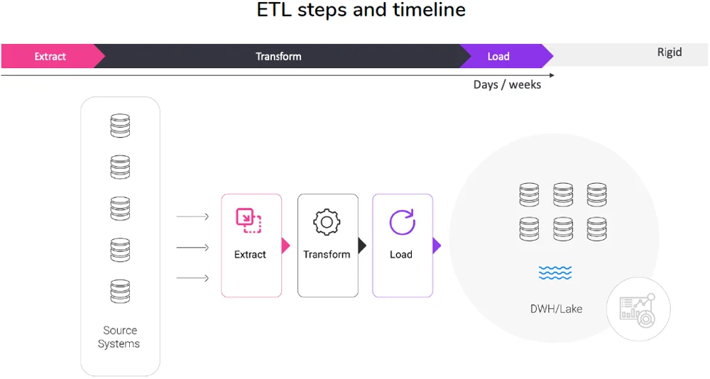
What is ETL

Slide 48
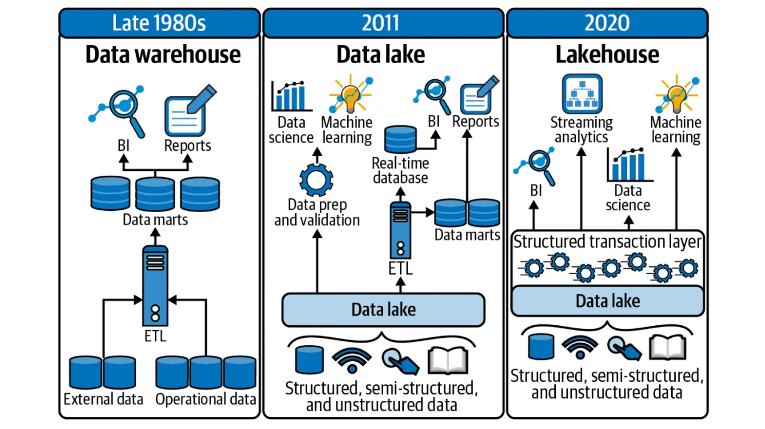
WHAT IS ETL

Slide 49
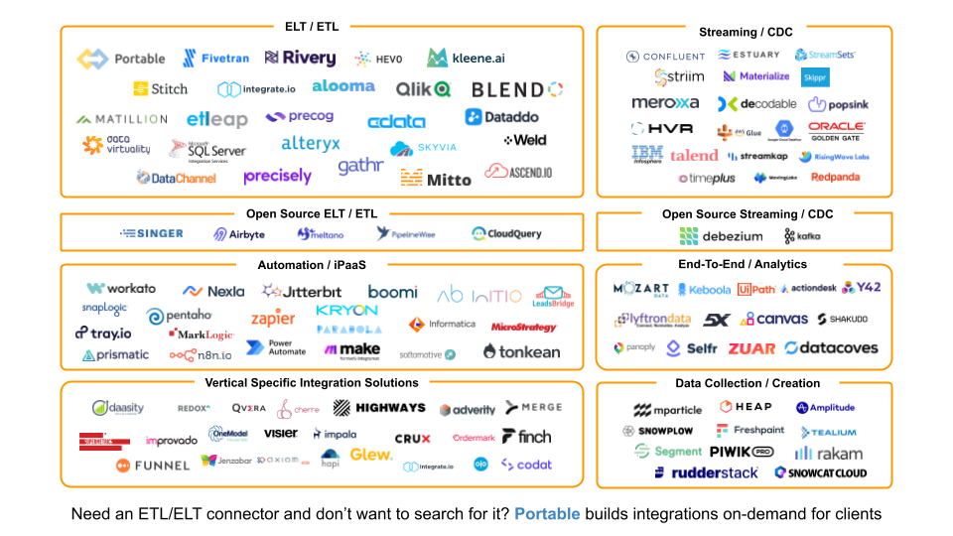
WHAT IS ETL

Slide 50
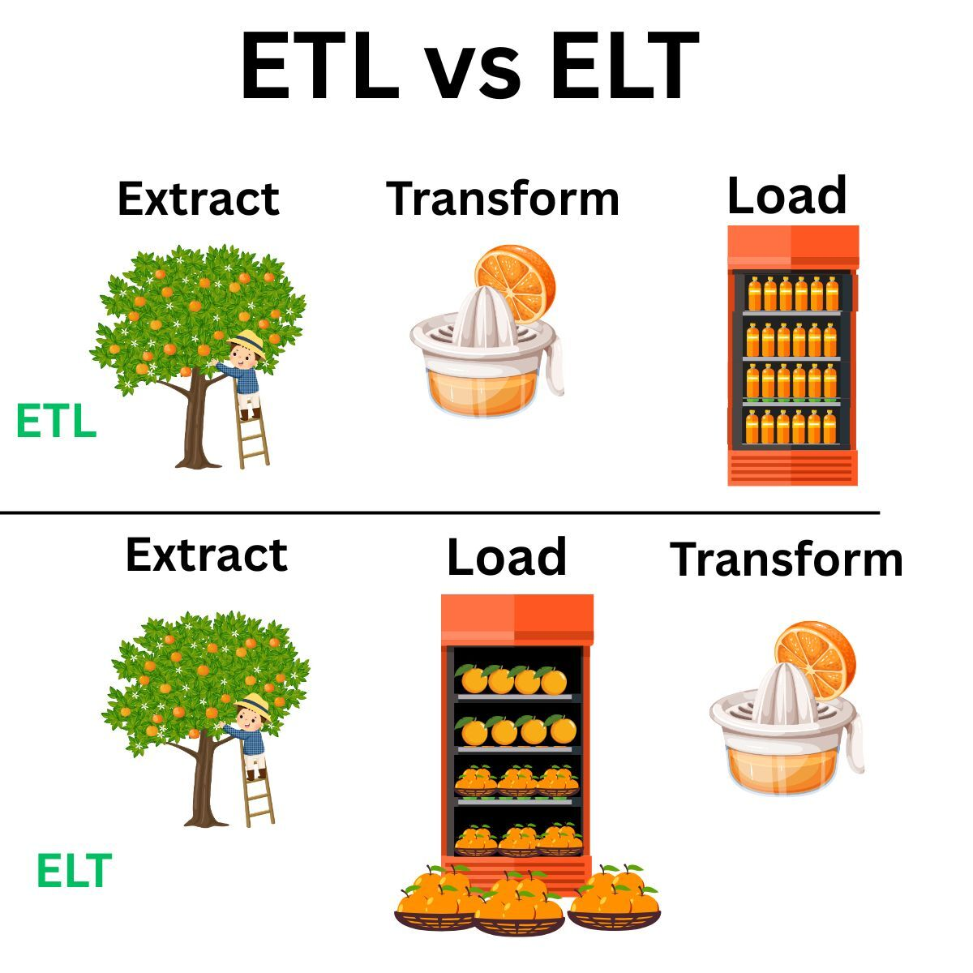
ETL vs ELT
ETL (Extract, Transform, Load) processes data transformations before loading it to the target.
ELT (Extract, Load, Transform) first loads data (often into a staging area or data lake) and then applies transformations downstream.

Slide 51
WHY ELT?
Why ELT is Increasingly Popular:
  Cheap Storage: With cloud storage costs dropping, it’s often more efficient to store data in its raw form and transform it later.
  Technological Advances: Frameworks like the medallion architecture (Bronze, Silver, Gold) and data lakehouse capabilities (schema evolution, time travel) make it easier to handle data in a “store first, act later” model.

Slide 52
COMMON TERMINOLOGY
Many people still use “ETL” as a catch-all term, even when the process is closer to ELT.
“Reverse ETL” pushes transformed data from a warehouse or lakehouse back into operational tools (e.g., CRM systems)

Slide 53
COMMON TERMINOLOGY
Core Concepts Remain the Same:
  Regardless of whether you use ETL or ELT, you still need to address data ingestion, transformation, and orchestration.
  Best practices in observability, troubleshooting, scaling, and optimization apply in both paradigms.

Slide 54
Extraction
Datasources:
  RDBMS
    Oracle
    PostgreSQL
    Microsoft SQL
    MySQL / MariaDB
  API
  Screen scraping
  Web spidering
  NoSQL
    MongoDB (json data store)
    ElasticSearch
    Hadoop / Hbase
    MapR
    Cassandra
    …
  Files
    XML
    JSON
    CSV/TSV
    …

Slide 55
DATA INGESTION
Purpose of Data Ingestion:
  Involves moving data from its source to a target system where it can be staged, processed, or analyzed—often for AI/ML tasks.
  Enables organizations to consolidate data for internal use, such as refining decision-making or building data-driven products.

Slide 56
DATA INGESTION
Growing Number of Data Sources:
  Modern businesses rely on a wide variety of external platforms (e.g., Google Analytics, LinkedIn, Meta, Mailchimp), leading to many different data feeds.
  Each data source may periodically change—adding or removing columns, renaming fields, or releasing new API versions.

Slide 57
DATA INGESTION
Challenges in Handling Changes:
  Adjusting to evolving schemas can be manageable for a single source but becomes increasingly complex with multiple sources.
  Data teams must balance a variety of ever-changing requirements from different departments.

Slide 58
DATA INGESTION
Need for Scalable Solutions:
  A core question for data engineers is how to provide reliable, user-friendly data access while ensuring the ingestion process remains flexible and robust.
  This includes designing architectures and pipelines that can handle shifting schemas and expanding data demands without manual intervention each time.

Slide 59
WHAT HAS CHANGED?
Modern Workflows:
  Most modern data engineering setups involve staging nearly all data in the cloud.
  Exceptions may arise with extremely high-volume data (e.g., IoT or sensor data) where aggregations or discards happen before cloud staging to manage costs and processing limits.
Core Focus:
  Regardless of method (ETL vs. ELT), ingestion still centers on pulling data from a source and writing it to a target.

Slide 60
SOURCE
  Multiple Sources: You will likely have many sources, each with unique requirements, necessitating a separate assessment for resources and ingestion strategy.
  Continuous Addition vs. Removal: In most organizations, new data sources are added frequently, while requests to remove existing ones are rare. Be prepared for ongoing growth in the number of sources.

Slide 61
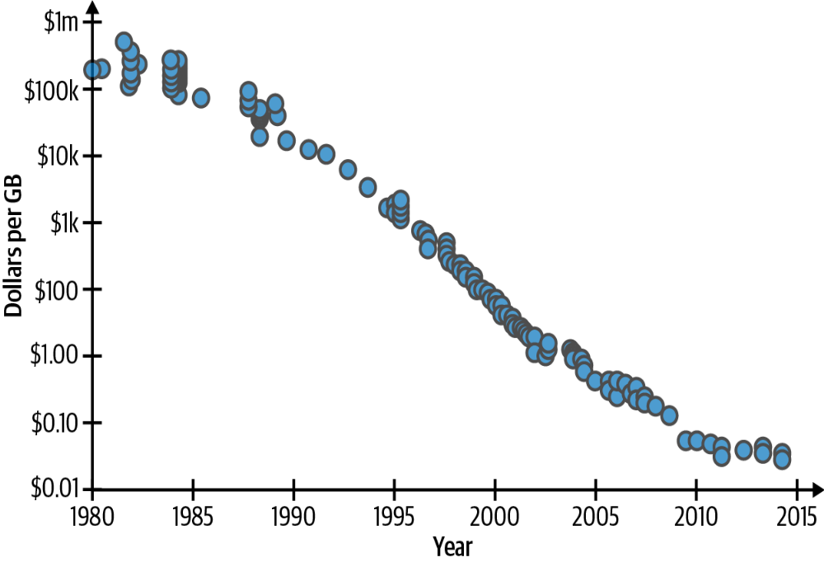
QUESTION TO ASK
Figure 1-1. Hard drive costs per GB, 1980 to 2015 (Source: Matt
Komorowski); the y-axis values are in log scale

Slide 62
CHECKLIST
Data Format:
  Identify how data is delivered (e.g., JSON via API, CSV over FTP, relational database dump).
  Determine whether the data source provides a well-defined schema or if it’s semi-structured/unstructured.
  Recognize that diverse formats can pose challenges, requiring different ingestion or parsing strategies.

Slide 63
CHECKLIST
Data Quality:
  Assess the dataset’s cleanliness and consistency (e.g., missing fields, inconsistent types, invalid values).
  Plan for any necessary transformations or data enrichment steps (e.g., augmenting records with external reference data).
  Ensure data meets the quality requirements of downstream consumers (e.g., analysts, ML models).

Slide 64
CHECKLIST
How Will the Data Be Stored?
  Even if you already have a data warehouse or lake, consider staging raw data for potential reprocessing or rollback.
  Confirm that your storage approach (e.g., medallion architecture, traditional warehouse) aligns with business needs and stakeholder expectations.
  Factor in both current and future requirements, such as accessibility, performance, and governance.

Slide 65
CHECKLIST
Question | Example
Who will we collaborate with? | Engineering (Payments)
How will the data be used? | Financial reporting and quarterly strategizing
Are there multiple sources? | Yes
What’s the format? | Semi-structured APIs (Stripe and Internal)
What’s the frequency? | Hourly
What’s the volume? | Approximately 1K new rows/day, with an existing pool of ~100K
What processing is required? | Data tidying, such as column renaming, and enrichment from supplementary sources
How will the data be stored? | Storing staged data in Delta tables via Databricks

Slide 66
DESTINATION
  Pre-Defined Storage: In most scenarios, you’ll be integrating data into an existing system where the storage technology is already decided.
  Importance of Destinations: Despite minimal focus in some discussions, destinations are critical to the overall value of the data system—how and where data is stored directly impacts usability and performance.
  Similar Checklist Approach: Just as you have a framework for sources, apply a similar evaluation to your destinations (e.g., understand frequency, format, performance needs).
  Fewer Destinations: Typically, there are far fewer destinations than sources, making the process of analyzing them a simpler exercise overall.

Slide 67
STAGING
Data Lake Approach:
  Ingest your data into cloud storage (e.g., AWS S3, GCP, Azure Blob) before loading it into a data warehouse.
  This simplifies the initial ingestion step and provides a central “raw data” repository.
Lakehouse Evolution:
  Leverage formats like Delta Lake to gain transactional guarantees, schema evolution, and time travel.
  This often eliminates the need for a separate data warehouse, because the lakehouse can provide analytics and SQL capabilities on top of your data lake.
  A governance layer (e.g., Unity Catalog) can further enhance discoverability, security, and collaboration across data assets.

Slide 68
STAGING
Metadata-Centric Formats:
  Use Parquet-based file formats such as Delta Lake, Apache Iceberg, or Apache Hudi for efficient data storage.
  Advantages include:
    Columnar compression for lower storage costs and improved query performance.
    Metadata layer enabling features like ACID transactions, time travel, and schema evolution.
Medallion Architecture Alignment:
  The Bronze (raw), Silver (cleaned), Gold (aggregated) layering pattern is well-suited for managing data quality over time.
  Preserving the entire data history enables simpler schema changes (e.g., adding new columns), easier data backfills, and more flexible analytics.

Slide 69
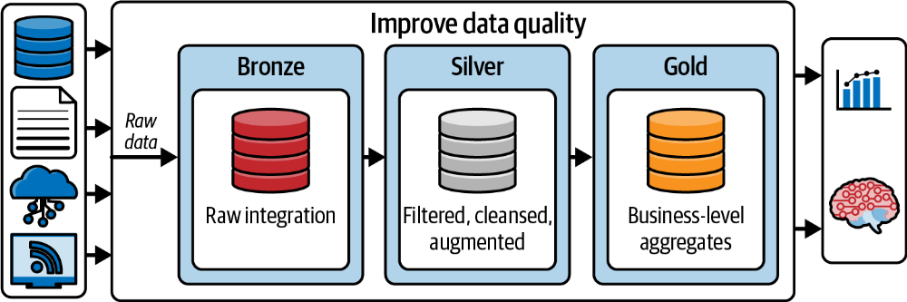
STAGING

Slide 70
WHY STAGING ?
A dedicated staging layer (e.g., Delta tables in your cloud storage) consolidates raw data before transformation and analytics.
It allows you to reprocess or fix historical data if errors occur—without having to re-pull from the original source.

Slide 71
OLAP VS OLTP
  OLAP (Online Analytical Processing): Suited for large-scale analytical queries, typically uses a distributed, column-oriented architecture. Examples include Amazon Redshift, Google BigQuery, Snowflake, and Databricks SQL.
  OLTP (Online Transaction Processing): Ideal for transaction-heavy workloads (e.g., processing inserts/updates from many concurrent users). Generally row-oriented. Examples include PostgreSQL, MySQL, and other traditional relational databases.

Slide 72
OLAP VS OLTP
Use Cases:
  OLAP Systems: Preferred by analytics and data science teams for high-speed queries, scalability, and easier maintenance.
  OLTP Systems: Used to handle large numbers of concurrent transactions, such as user interactions in an application

Slide 73
KEY CONSIDERATIONS
Computing Platform Alignment:
  Consider synergy with your existing tech stack.
  For example, if most tools live in AWS, Redshift might simplify implementation.
  A platform like Databricks integrates storage (Lakehouse), governance (Unity Catalog), and compute (Apache Spark).

Slide 74
KEY CONSIDERATIONS
Cost:
  Pricing structures (e.g., pay-per-data-scanned vs. pay-per-compute vs. storage-based) vary widely.
  Actual costs may be unclear until the system is in use.
  Techniques like partitioning or filtering can reduce data scan costs (e.g., in BigQuery).
  Lakehouse architectures (e.g., with Delta Lake) avoid data duplication between a lake and a warehouse, potentially reducing storage costs.
  Research is essential—large-scale usage can make any warehouse expensive if not optimized.

Slide 75
FREQUENCY
Data Bounds
  Bounded: The dataset has a definite start and end (e.g., a finite CSV or a historical dataset).
  Unbounded: The dataset is continuous and does not end (e.g., real-time logs, sensor data)

Slide 76
BATCH INGESTION
Batch Ingestion:
  Groups Data: Collects data over a certain period before processing it in bulk.
  Use Cases: Periodic reporting, daily/weekly data loads, or any scenario where slight delays are acceptable.

Slide 77
STREAMING INGESTION
Streaming Ingestion:
  Captures Events as They Happen: Ingests data continuously, enabling near real-time updates.
  Use Cases: IoT sensor data, financial tick data, real-time user interactions, or any application where immediate insights or actions are crucial.
Overall, understanding whether your data is bounded or unbounded—along with the organization’s business needs—helps determine if batch or streaming ingestion is the right approach.

Slide 78
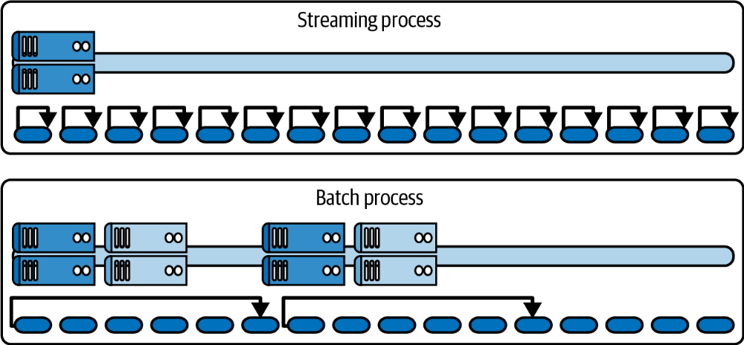
STREAMING INGESTION
Latency is the property that defines “batch” or “streaming”
processes; beyond some arbitrary latency threshold, we consider data
“streamed” (courtesy of Denny Lee)

Slide 79
TRANSFORMATION

Slide 80
PYTHON
Programming Language Choice: Determines the libraries, frameworks, and methods for data transformation.
Python for Data:
  Popularity & Longevity: Python remains a leading language for data science and transformation, showing strong dominance over the past decade.
  Core Library – Pandas: Provides robust data manipulation and analysis tools, complemented by numerous I/O libraries.
  Scaling Challenges: Historically, Python struggles with very large datasets, prompting the use of libraries like Dask and Ray to distribute workloads.
  Recent Advancements: Ongoing innovations in Python-based data processing indicate a “renaissance,” offering more efficient, scalable options for big data workloads.

Slide 81
PYTHON
  Library Selection: Begin with a well-established library like Pandas for robust data manipulation.
  Emerging Alternatives: Consider newer options such as Polars or DuckDB, which offer innovative features and performance benefits.
  Execution Framework: After choosing a library, pick an orchestration/execution framework (e.g., Airflow, Prefect, Dagster) that best aligns with your workload and scaling requirements.

Slide 82
SQL
Declarative Nature of SQL:
SQL focuses on what you want rather than how to get it
Imperative Twists:
  In practice, SQL can become “imperative” through complex queries.
  Despite this, it’s still more constrained compared to general-purpose languages like Python or Java.
Templating & Extensions:
  To overcome SQL’s inherent limitations, developers often pair it with a templating or scripting solution for more advanced logic.
  Common examples include dbt (which uses Jinja/Python) or Dataform (using JavaScript).
Most SQL Transformations:
  Typically run inside a data warehouse environment (e.g., Snowflake, BigQuery, Redshift) to leverage its computational power and native SQL support.

Slide 83
FRAMEWORK

Slide 84
FRAMEWORK
Definition & Purpose:
  Transformation frameworks enable distributed computing across multiple machines or clusters.
  They typically offer APIs in multiple languages (e.g., Python, SQL, Scala), making it easier to build and run large-scale data transformations.
Parallelization & Distributed Computing:
  By splitting workloads across many nodes, these frameworks can process big data more efficiently than single-machine solutions.
Data Warehouses as Engines:
  Many data warehouses (e.g., Snowflake, BigQuery, Databricks SQL) also provide distributed execution capabilities.
  They can be viewed as “transformation engines” where SQL queries or UDFs (user-defined functions) run at scale in parallel.

Slide 85
FRAMEWORK HADOOP
Origins and Adoption:
  Hadoop emerged in the mid-2000s, initially championed by large tech companies like Yahoo, Facebook, and Google to handle explosive data growth.
Core Components:
  Hadoop Distributed File System (HDFS): Manages storage across distributed nodes.
  MapReduce: A programming model optimized for batch processing, though less effective for real-time or iterative tasks.

Slide 86
FRAMEWORK HADOOP
Limitations:
  Batch-Focused: Not ideal for near real-time processing or iterative workloads.
  Performance Constraints: Disk-based processing can be slower compared to in-memory solutions.
Rise of Spark:
  Spark offers in-memory processing, making it faster for diverse workloads (batch, streaming, ML).
  Spark’s flexible APIs (Python, Scala, R, SQL) contributed to its rapid adoption over Hadoop MapReduce.
Current Landscape:
  Hadoop is still in use, but its dominance has diminished in favor of cloud-based and serverless data warehouses.
  Many organizations adopt hybrid architectures, leveraging Hadoop alongside other modern data platforms.

Slide 87
FRAMEWORK SPARK
Origin & Purpose:
  Spark was developed at UC Berkeley as an alternative to Hadoop’s MapReduce, addressing performance bottlenecks by introducing in-memory data processing.
Resilient Distributed Datasets (RDDs):
  A key innovation in Spark, enabling fault-tolerant in-memory computations that drastically speed up big data processing.

Slide 88
FRAMEWORK SPARK
Integration with Databricks:
  Spark’s original creators founded Databricks, which provides a managed platform for easier Spark adoption, offering collaboration, scalability, and simplified setup.
Language Support:
  High-level APIs in Java, Scala, Python, and R make Spark accessible to a wide range of data professionals.
Recommendation:
  For those starting out, a managed platform like Databricks offers a low barrier to entry and streamlined environment for data transformation and analytics.

Slide 89
BUILDING TRANSFORMATION

Slide 90
ENRICHEMENT
Enrichment:
  Enhance existing data by adding additional information.
  Example: Convert non-human-readable internal status codes (e.g., “1337”) into descriptive statuses (e.g., “complete”) by joining with reference data.

Slide 91
JOINING
Joining:
  Combine two or more datasets based on common fields, similar to SQL JOIN operations.
  Example: Merge sales data with user data to include the originating country, providing more complete analysis.

Slide 92
FILTERING
Filtering:
  Select only necessary data points based on specific criteria to reduce volume and improve quality.
  Example: Remove records prior to a specific date (e.g., include only records from 2024 onward).

Slide 93
STRUCTURING
Structuring:
  Reformat data into a required layout or structure (e.g., converting semi-structured data into a table).
  Example: Transform JSON data from a financial API into a tabular format suitable for storage in a Parquet file.

Slide 94
CONVERSION
Conversion:
  Change data types to meet specific format requirements.
  Example: Convert a timestamp provided as a string (e.g., “2011-01-01 00:00:00”) into a proper date/time format for analysis.

Slide 95
AGGREGATION
Aggregation:
  Summarize and combine data, such as computing totals or averages.
  Example: Aggregate millisecond-level IoT sensor data into per-second summaries to enable efficient analysis.

Slide 96
ANONYMIZATION
Anonymization:
  Mask or obfuscate sensitive information to protect privacy.
  Example: Hash email addresses to create unique identifiers while ensuring that personal data is not exposed.

Slide 97
SPLITTING
Splitting:
  Divide a single, complex data field into multiple, simpler components.
  Example: Split an email address into prefix and domain; discard the prefix to maintain anonymity while retaining the domain.

Slide 98
DEDUPLICATION
Deduplication:
  Remove redundant records to ensure data uniqueness.
  Example: Identify and remove duplicate event UUIDs from a data stream, keeping only the earliest occurrence.

Slide 99
DATA UPDATE PATTERNS

Slide 100
INSERT
Insert:
  Append new data to an existing source instead of overwriting it.
  Only adds new rows; no existing data is altered.
  Ideal for cases where new data is independent of old data (e.g., daily transactions, stock market data).
  Incremental insertion is a fast and simple method to keep data sources up-to-date.

Slide 101
UPSERT
Upsert (Update + Insert):Combines updating existing records with inserting new ones based on a unique identifier.
Particularly useful for change data capture, sessionization, and deduplication.
Mechanism:
  Identify records using a predefined unique key.
  Update records that already exist.
  Insert new records if no matching record is found.
Complexity:
  More intricate than simple insert operations, often necessitating specialized functionality.
  Platforms like Databricks simplify upsert operations with built-in MERGE functionality.

Slide 102
UPSERT
Example (Databricks MERGE Statement):
Merges data from an update source into an existing table by updating matched records and inserting unmatched ones.
Sample Query:
MERGE INTO table1
USING table_reference
ON (conditions)
WHEN MATCHED THEN
UPDATE SET table1.colonne1 = valeur1, table1.colonne2 = valeur2
DELETE WHERE conditions2
WHEN NOT MATCHED THEN
INSERT (colonnes1, colonne3)
VALUES (valeur1, valeur3)

Slide 103
DELETE
  Definition: Removing data records from a database.
  Types of Deletion:
    Hard Delete: Permanently removes the record, completely erasing it from the system.
    Soft Delete: Marks the record as deleted (e.g., setting a status to “deleted”) while retaining it for historical or recovery purposes.
  Regulatory Considerations:
    Privacy laws, such as GDPR, often favor hard deletes to ensure sensitive information is completely removed.
  Use Cases for Soft Deletes:
    Maintaining a historical record of changes, such as tracking digital asset status in a SaaS environment.
    Supporting data recovery and analysis (e.g., understanding account terminations) by keeping a trail of what was “deleted.”
  Trade-offs:
    Hard Deletes:
      Pros: Ensures data is fully removed, reducing storage and complying with privacy regulations.
      Cons: Loses historical context and may hinder recovery if data is mistakenly removed.
    Soft Deletes:
      Pros: Preserves historical data for analysis and recovery, offering more flexibility.
      Cons: Requires additional management to distinguish between active and “deleted” records.

Slide 104
BEST PRACTICES

Slide 105
STAGING
  Utilize a medallion architecture (e.g., Bronze, Silver, Gold) to stage data in a data lake or warehouse.
  Staging is essential to protect against data loss and ensure low time to recovery (TTR) in case of failures.

Slide 106
IDEMPOTENCY
  Ensure that running the transformation multiple times with the same input yields consistent results.
  This principle is key for handling failures and maintaining data consistency in distributed systems.

Slide 107
NORMALIZATION-DENORMALIZATION
  Normalization: Refine data into a clean, orderly format, ensuring uniqueness and proper structuring (often with primary keys).
  Denormalization: Duplicate data strategically to enhance performance for analytic queries or downstream processing.

Slide 108
INCREMENTALITY
  Decide whether to refresh the entire dataset (INSERT OVERWRITE) or update only changed records (UPSERT).
  Use patterns and tools (e.g., dbt, Airflow, or MERGE operations in Databricks) to build efficient incremental pipelines that reduce compute costs and improve performance.

